Slide 1
College Rating System
Nitesh desai - 240160510009

Slide 2
1. Existing System
various online platforms that provide college rankings and related information to assist students in making informed educational choices. Websites such as CollegeDekho, Niche, Times Higher Education World University Rankings, and Princeton Review are examples. These platforms typically offer rankings based on a combination of factors, including academic syllabus, institutional reputation, course offerings, and infrastructure quality
2.Existing System Problems
This available system keeps in mind the college facilities, results of the college, faculty. They conduct surveys based on that and then decide the college's rating and ranking.

Slide 3
They don't do actual surveys like College Student Opinion. They don't even allow college students to come and rate their colleges on their website.

Slide 4
3.New System
This system allows college students to rate their college and their teachers. This system shows the college rating and the teacher's rating.
these platforms often aggregate data and generate rankings overlooking subjective factors like personal experiences with teachers or campus life that vary from student to student.
4. Need for a New System
Existing systems did not allow students to rate college and their teachers.
New students get the perfect college because there are no surveys like other systems which may be wrong.
existing systems like CollegeDekho and Niche, which often rely on generalized metrics such as placement records or faculty qualifications that may not reflect individual student experiences.

Slide 5
5. Use case
Admin can login, View All Colleges, Manage College Admin Add College. Student can login,Rate College, Rate Teacher.HOD can login,Add Course,teacher,student, Edit College,student,Teacher
,course detail, delete student,Teacher,course

Slide 6
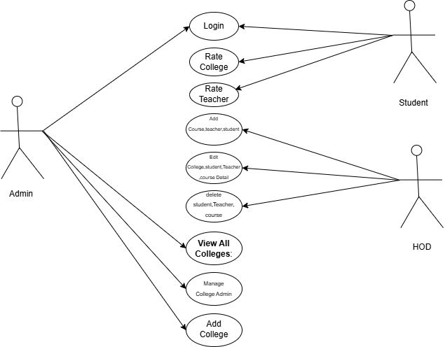

Slide 7
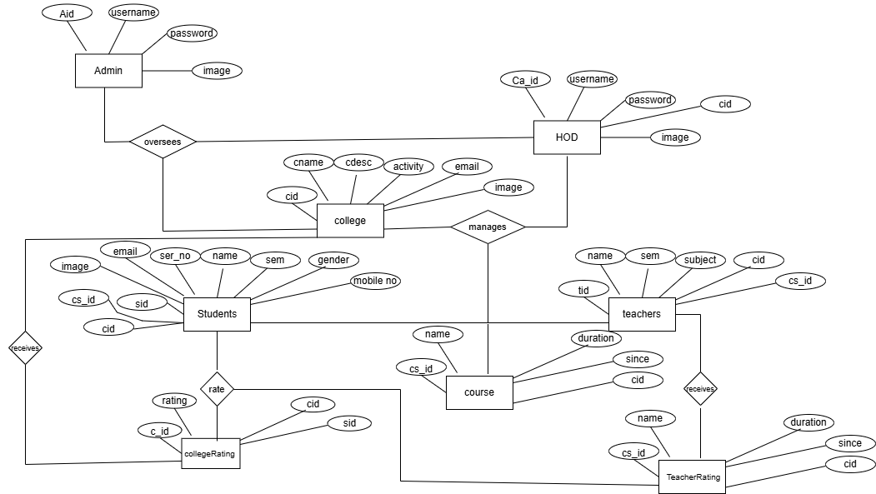
5. Entity Relationship Diagram

Slide 8
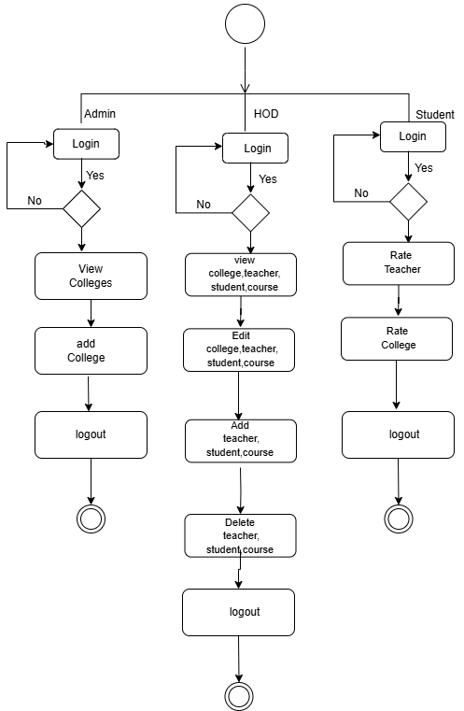
6.Activity Diagram

Slide 9
7. Data Dictionary
Admin( Aid,Username,Password,Image)
HOD( ca_id,username,passwod,cid,image)
Colleges( cid,cname,cdesc,activity,address,email,image)
Student( sid,ser_no,name,sem,gender,mobileNo,email,image,cid,cs_id)
Teacher( tid,name,sem,subject,image,cid,cs_id)
Course( cs_id,name,duration,since,cid)
CollegeRating( c_id,rating,cid,sid )
TeacherRating( tr_id,rating,tid,sid)

